Slide 1

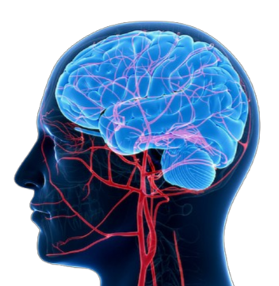
Metro College of Technology
Toronto
Comprehensive Analysis of
Brain Stroke Prediction
Final project - MLDL Course
By Shirmila Hewapathirana
Professor: Mr. Amit Kukreja
Submitted on March 14, 2025

Slide 2
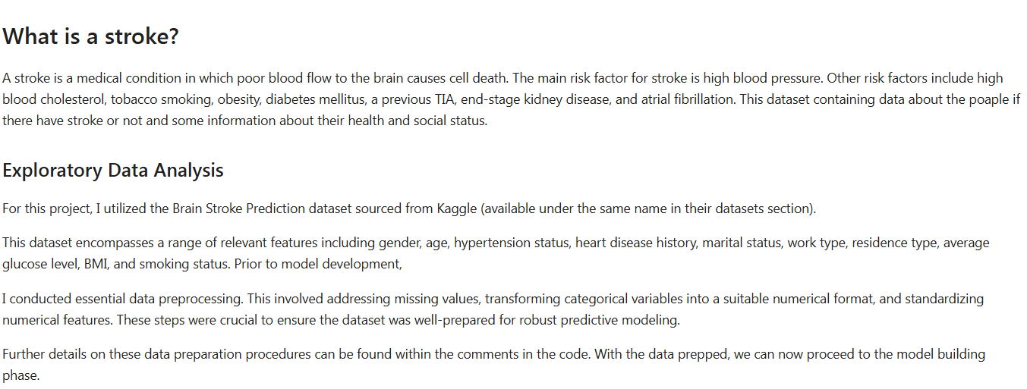
Executive Summary

Slide 3
Summary of Dataset
 | Feature | Description | Dtype
1 | id | : Unique identifier | int64
2 | gender | : Gender(Male, Female, Other) | object
3 | age | : Age of the patient | float64
4 | hypertension | : 'No' if the patient doesn't have hypertension, 'Yes' if the patient has hypertension | object
5 | heart_disease | : 'No' if the patient doesn't have any heart diseases, 'Yes' if the patient has a heart disease | object
6 | ever_married | : 'Yes' if the patient is married, 'No' if the patient is not married | object
7 | work_type | : Profession of the patient (children, Govt_job, Never_worked, Private, Self-employed) | object
8 | Residence_type | : Residence category of the patient (Rural, Urban) | object
9 | avg_glucose_level | : Average glucose level in blood of the patient | float64
10 | bmi | : Body Mass Index of the patient | float64
11 | smoking_status | : Smoking status of the patient (formerly smoked, never smoked, smokes, Unknown) | object
12 | stroke | : 1 if the patient had a stroke or 0 if not | int64
Notes:
File type : csv Total records: 5,110 Total features: 12 (5 numerical, 7 categorical) Target feature: Stroke

Slide 4
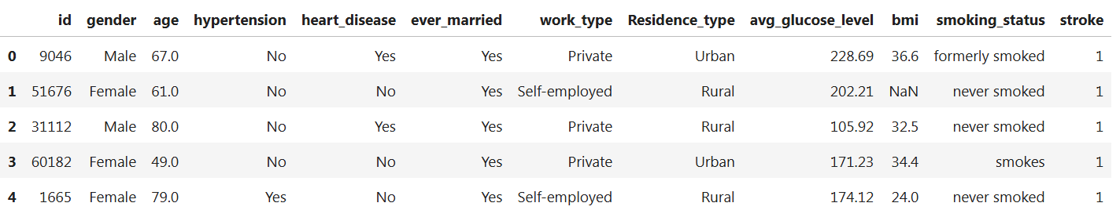
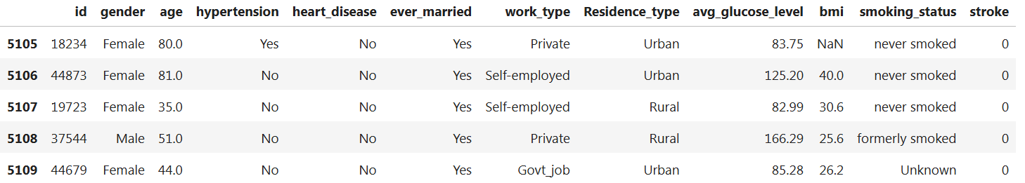
Head and Tail of the Dataset

Slide 5
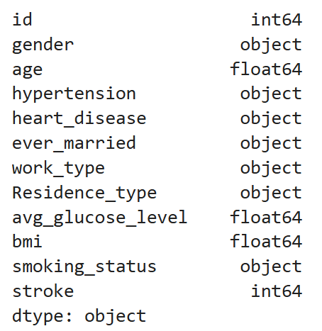
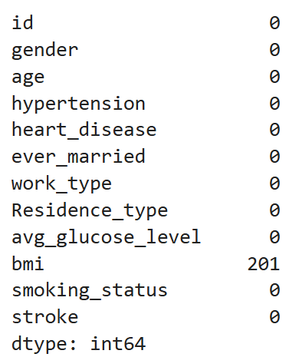
Data Types Missing Entries

Slide 6
Exploratory Data Analysis
There were 201 missing values in bmi. I dropped the rows that have missing bmi values.
There is no duplicate values in this dataset.
I have encoded the categorical features into numerical form.
‘id’ feature was dropped as it was not important for the analysis.
‘Other’ gender level with frequency of 1 was dropped from the dataset..
‘Never worked’ level with frequency of 22 will also be dropped from the dataset.
Outliers found in the data set was dropped

Slide 7
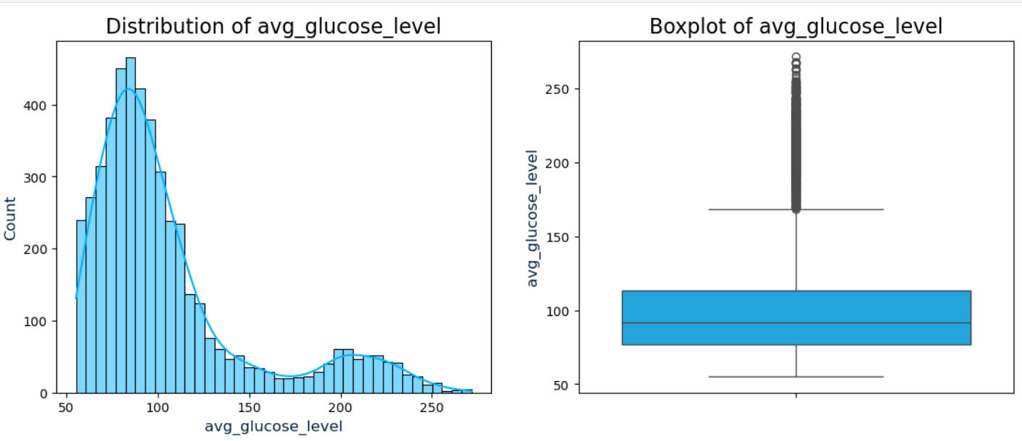
Univariate Analysis: Population Distribution by ‘Avg_Glucose_Level’

Slide 8
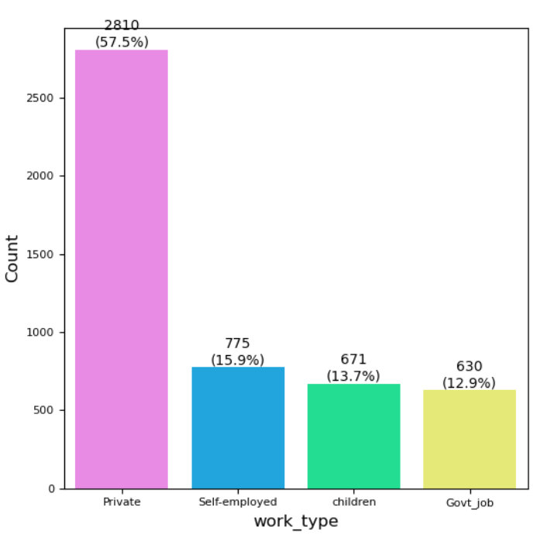
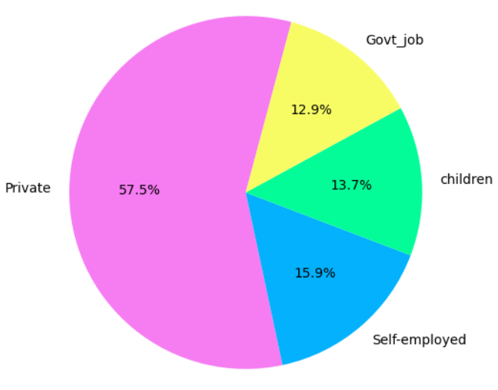
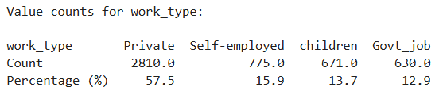
Univariate Analysis: Population Distribution by ‘Work_Type’

Slide 9
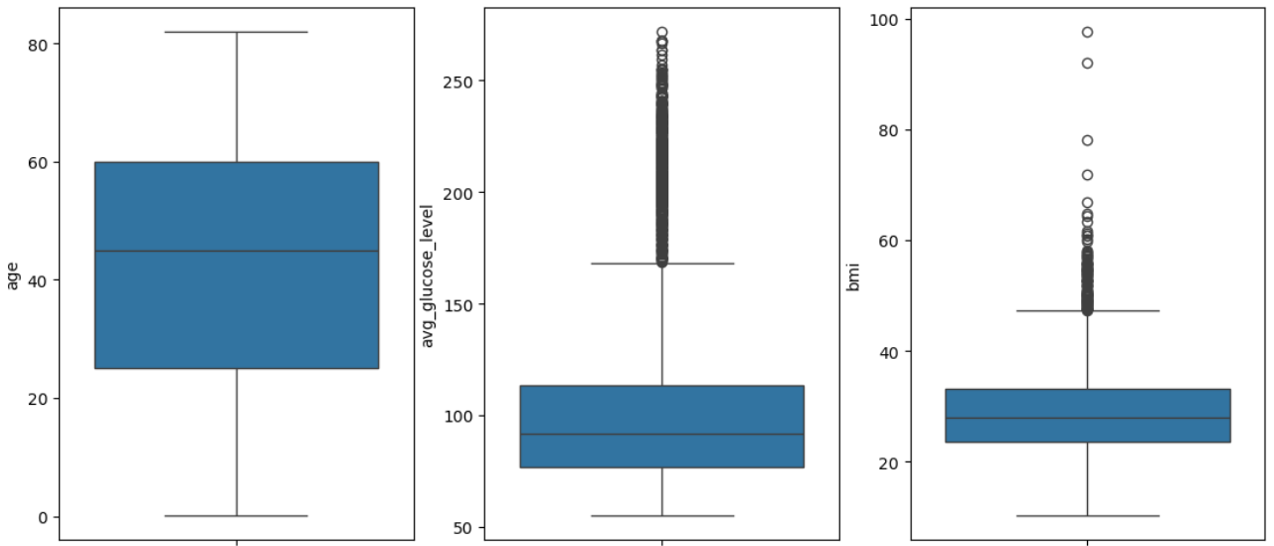
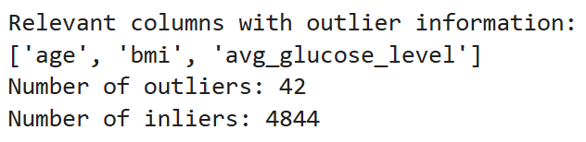
Outlier Detection: LoF(Local Outlier Factor Method)

Slide 10
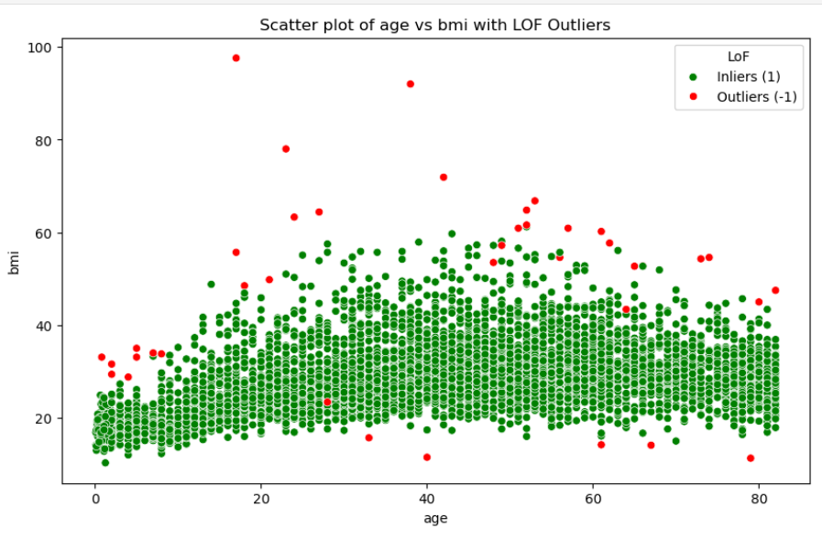
Outlier Detection: LoF(Local Outlier Factor Method) / Contd..

Slide 11
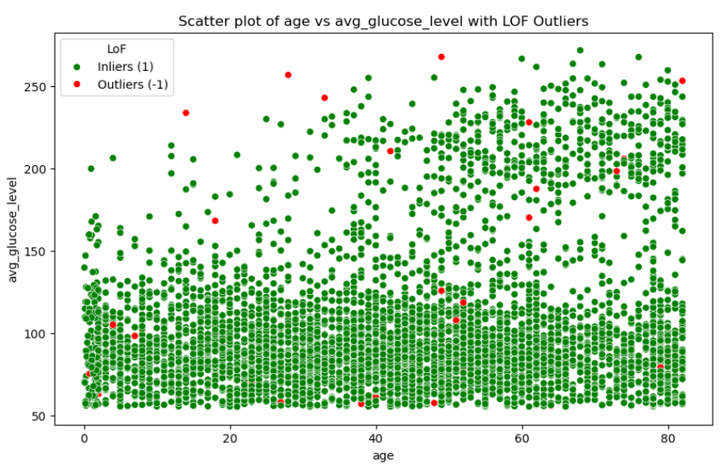
Outlier Detection: LoF(Local Outlier Factor Method) / Contd..

Slide 12
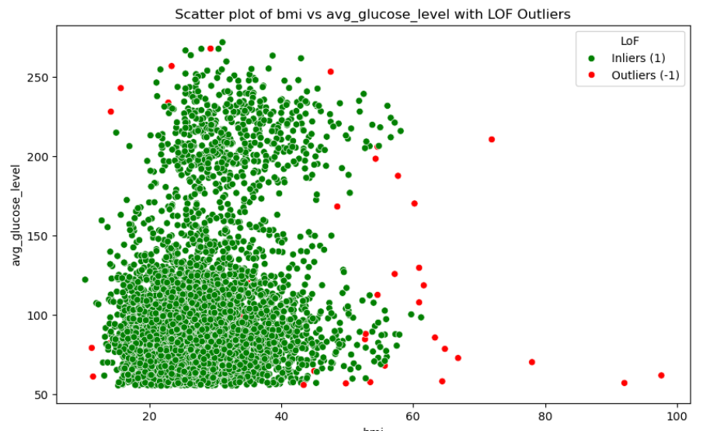
Outlier Detection: LoF(Local Outlier Factor Method) / Contd..

Slide 13
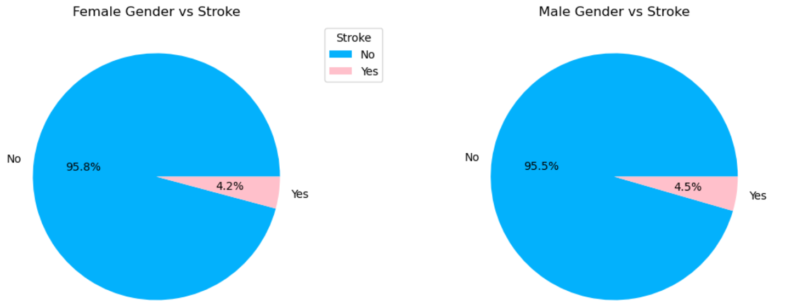
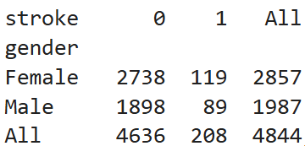
Bivariate Analysis: Categorical Data – Stroke by Gender

Slide 14
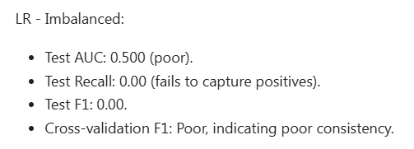
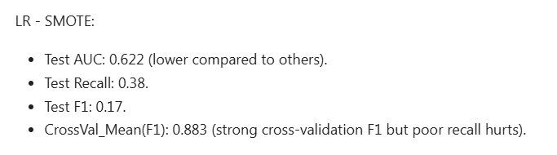
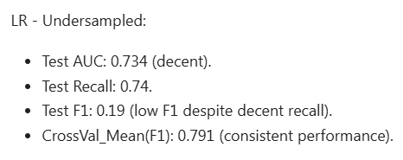
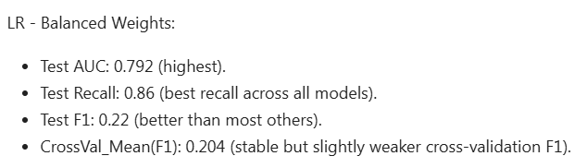
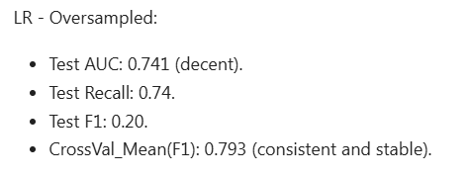
LOGISTIC REGRESSION AND DECISION TREE ANALYSIS
Logistic Regression Classifier – Summary

Slide 15
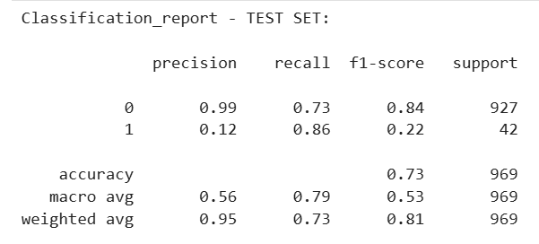
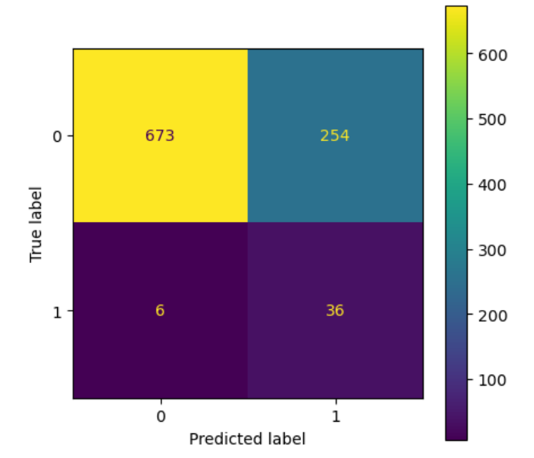
LOGISTIC REGRESSION AND DECISION TREE ANALYSIS
Logistic Regression Classifier - Conclusion
Train f1 score : 0.2127 Test f1 score : 0.2169
The "LR - Balanced Weights" model is the best choice for this dataset based on:
Highest AUC-Test (0.792).
Best Test Recall for positive class (0.86).
Decent Test F1 Score and CrossVal_Mean(F1). Since objective of this analysis is stroke prediction, capturing true positives is crucial and this model is highly suitable.

Slide 16
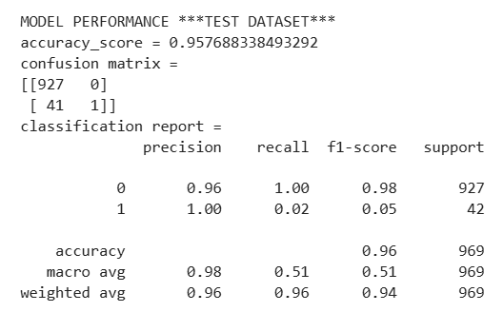
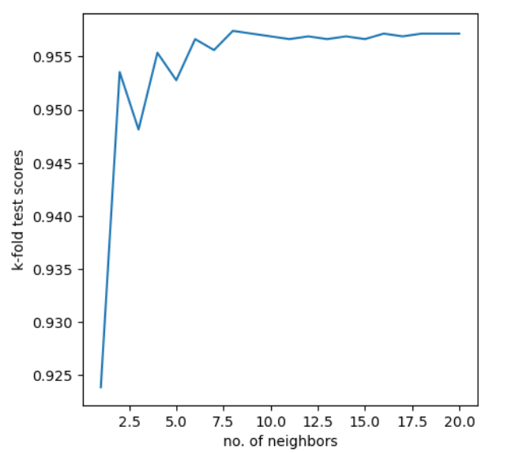
LOGISTIC REGRESSION AND DECISION TREE ANALYSIS
K Nearest Neighbor (KNN)
Overall Accuracy: The model achieves a high overall accuracy of 95.77% on the test dataset, indicating strong predictive capabilities.
Class 0 Performance: It demonstrates excellent performance in correctly identifying class 0 instances, with a precision of 0.96, recall of 1.00, and an F1-score of 0.98.
Class 1 Performance: However, the model struggles with class 1, exhibiting very low recall (0.02) and F1-score (0.05), suggesting a significant number of false negatives. This highlights a critical need for the model to better detect the minority class.
K-Fold Test Scores
Optimal Number of Neighbors: The graph shows a significant improvement in test scores from k=1 to around k=5. After k=5, the test scores continue to improve slightly and then start to plateau around k=10.
Performance Plateau: This plateau indicates that increasing the number of neighbors beyond k=10 does not contribute much to improving the model's performance, suggesting an optimal range for the number of neighbors.
The model’s performing with high overall accuracy but poor minority class detection.

Slide 17
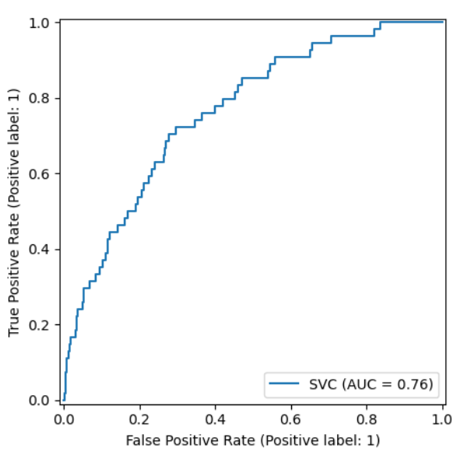
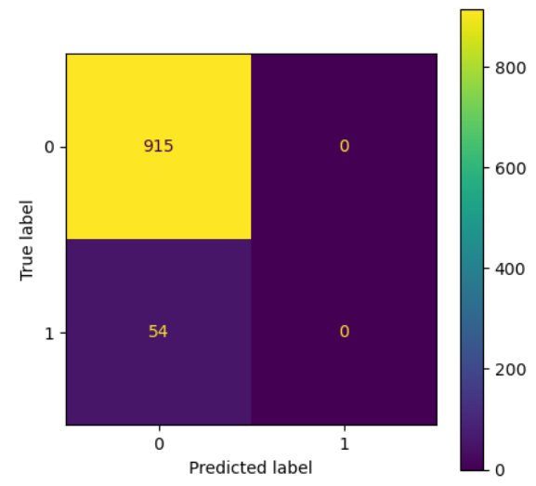
LOGISTIC REGRESSION AND DECISION TREE ANALYSIS
Support Vector Machine (SVM)
Best Parameters – Grid Search: {'C': 0.1,
'degree': 1,
'gamma': 0.03,
'kernel': 'linear’,
'probability': True}
The Area Under the Curve (AUC) is a measure of the model's ability to distinguish between the positive and negative classes. An AUC of 0.76 suggests that the model has a moderate level of predictive power, with values closer to 1 indicating better performance.
54 false negatives (incorrectly predicted but no false positives

Slide 18
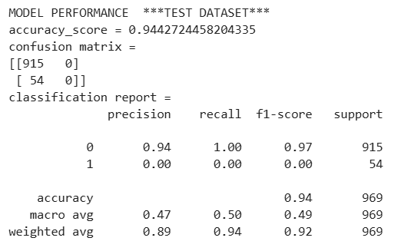
LOGISTIC REGRESSION AND DECISION TREE ANALYSIS
Support Vector Machine (SVM)/Contd..
Accuracy Score: High overall accuracy of 94.43% on the test dataset, indicating strong predictive capabilities.
Confusion Matrix: The model correctly identifies 915 instances of class 0 but fails to identify any instances of class 1, resulting in 54 false negatives.
Precision and Recall: For class 0, the model shows excellent precision (0.94) and perfect recall (1.00). However, for class 1, both precision and recall are 0.00, indicating a complete failure to detect positive cases.
F1-Score: The F1-score for class 0 is 0.97, reflecting its high precision and recall. For class 1, the F1-score is 0.00 due to the lack of true positives

Slide 19
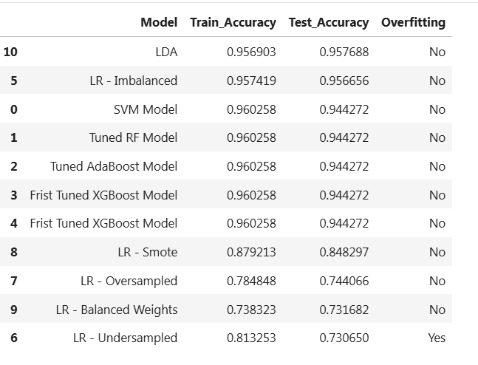
Overfitting
Test scores are almost same as the Train Accuracy scores. Hence, I conclude that there is no noticeable overfitting in these models

Slide 20
Thank you!

